Slide 1

Sutron X-link 500: BASIC TRAINING

Slide 2

Introduction to the Sutron X-link
Sutron is a brand of OTT Hydromet (owned by Danaher)
Danaher also owns Hach and McCrometer (yay…)
The X-link 500 is a datalogger
Multi-channel data logging (level, velocity, rain etc)
Various connection types (SDI-12, RS485, RS232, etc)
And controller
Runs Python code to do “stuff”
Control samplers
Calculate measurements (ex. area x velocity = flow)
And telemetry
Cellular
Satellite
Active and passive
Hi!

Slide 3
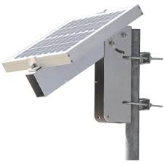

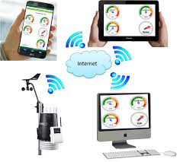
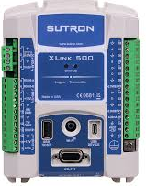
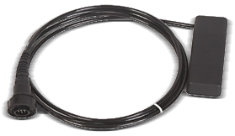
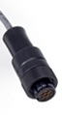
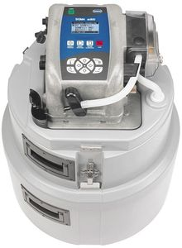
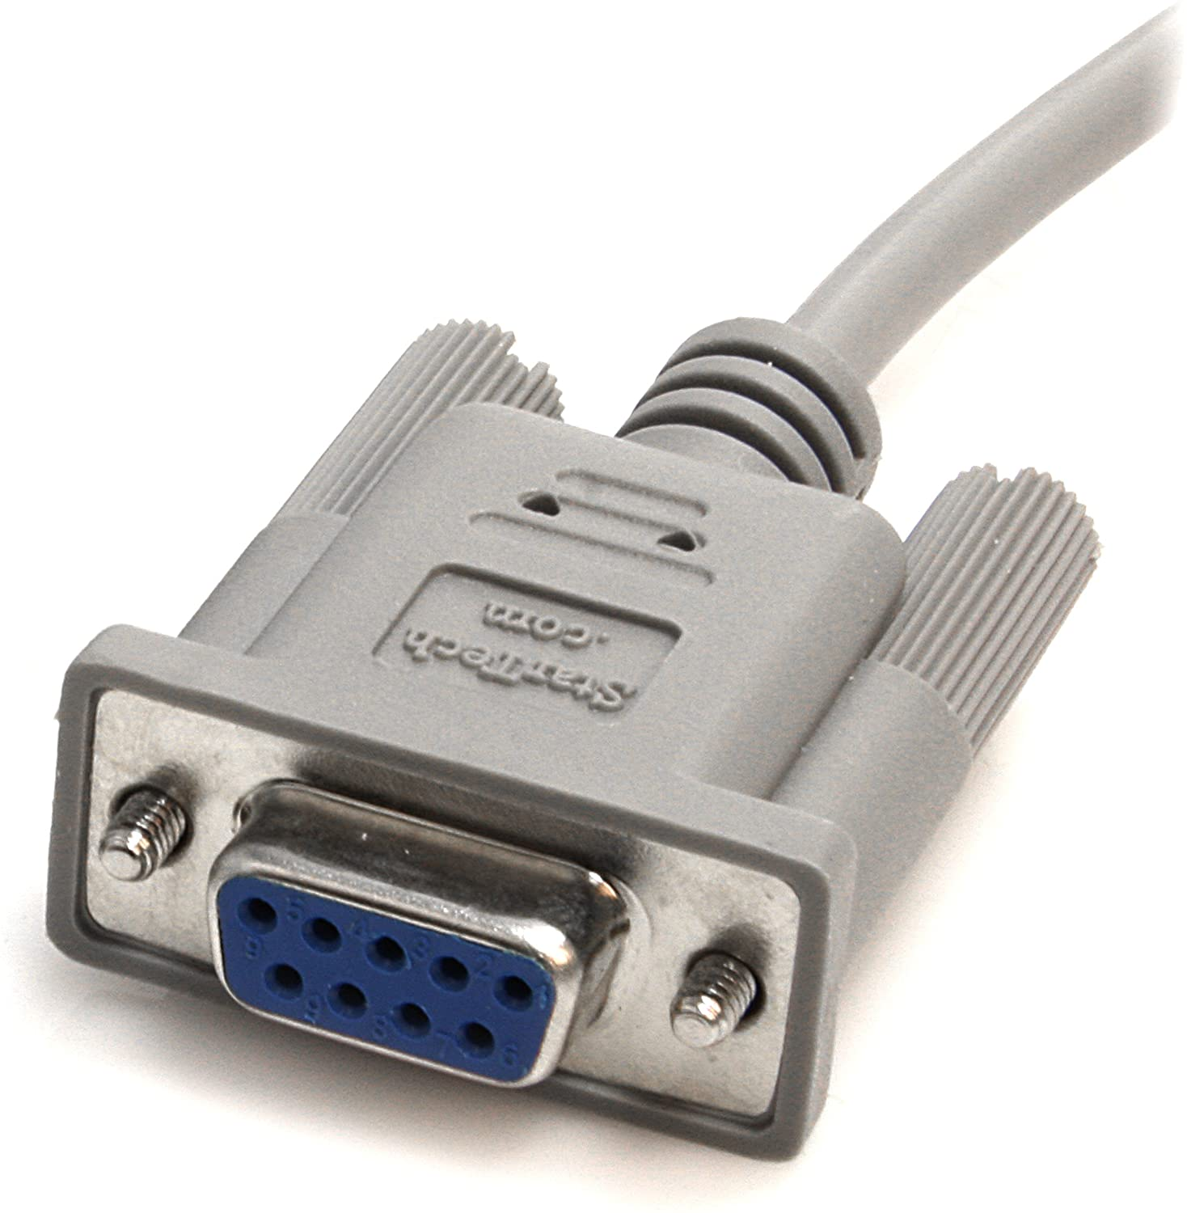
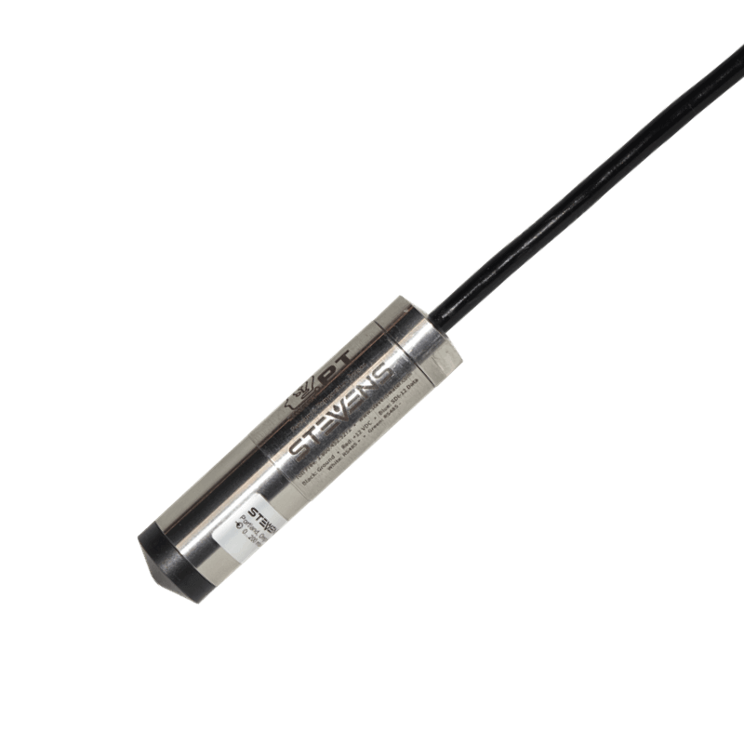
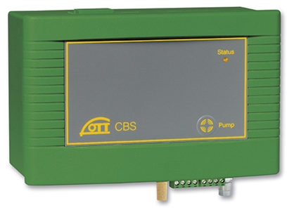
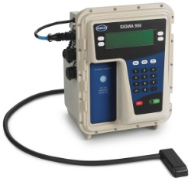
The Sutron Universe
$100
$300
$1,600
Cell modem to
Phone, PC, server
$10-20/month
PSA-AV
sensor
Sensor | Level | Velocity | Price
PSA-AV | ✓ (PT) | ✓ | $2,200
Sigma 950 | ✓ (bubbler) | ✓ | Priceless
Stevens PT | ✓ (PT) | HvF table | $800
OTT | ✓ (bubbler) | HvF table | $2,800
$2,200
Item | Cost
Sutron | $1,600
Flow | $800 – $3k
Sampler | $1k - $3k
Power | $100-400
Telemetry | $120-240/yr
Enclosure | $100-300
Total | $4k – $8k
Sampler
$1,000-3,000
Sigma 950
flowmeter
StevensWater
“SmartPT”
OTT Bubbler
Priceless
$800
$2,800

Slide 4
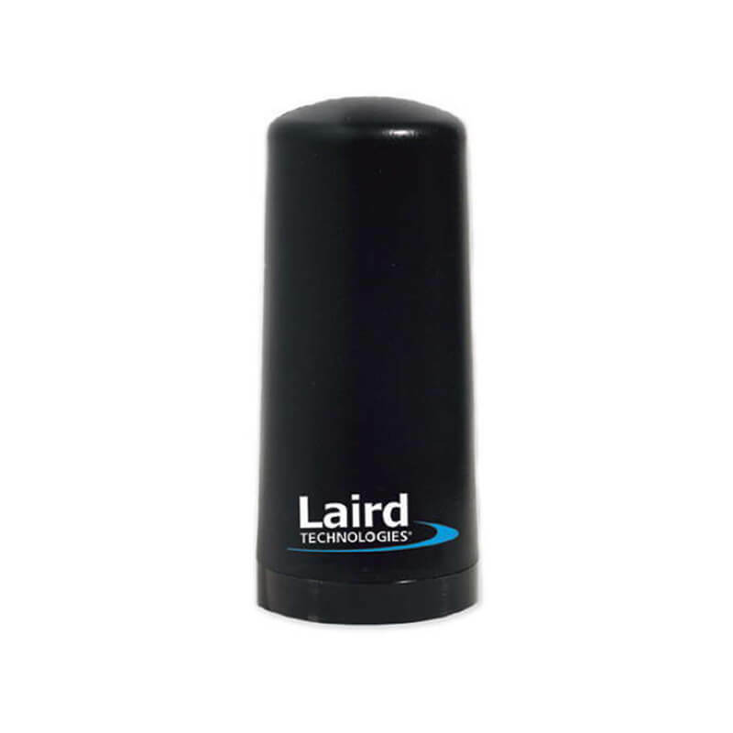
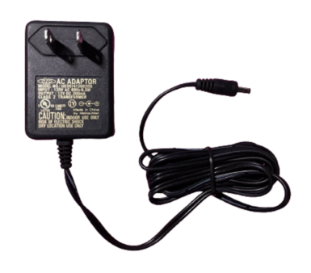
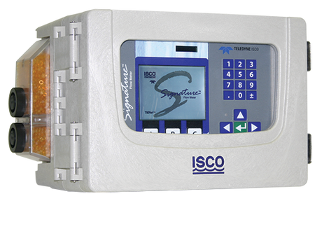
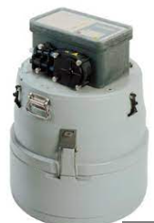
AC to DC power supply
Cellular antenna
ISCO Signature
flowmeter
Cell modem to
Phone, PC, server
RS-485
MODBUS
Sensor | Comm | $$
Signature | RS-485 | NA
3700 Sampler | V pulse | NA
Sutron Xlink |  | $1,600
Cell data plan |  | $150/yr
Antenna w/cable |  | $300
Sampler control cable |  | $250
Enclosure |  | $200
Power Supply |  | $50
Total: |  | $2,400 +cell plan
Hach sampler
control cable
Enclosure
ISCO 3700
Sampler

